Slide 1
Charlotte, NC
June 2008
“ RETS – REMP Workshop 2008”
Application Update of ANI Guideline 07-01
“Potential for Unmonitored & Unplanned Off-Site Releases of Radioactive Material”
William Wendland, P.E.
American Nuclear Insurers Glastonbury, Connecticut USA
AMERICAN
NUCLEAR
INSURERS

Slide 2
Risk
Term is all inclusive, many components
Biological
Radiological
Financial
Corporate Liability
Others
“Rets-Remp Workshop 2008”
AMERICAN
NUCLEAR
INSURERS

Slide 3
Nuclear Liability Insurance Risk
$300 Million US Provided to Each US NPP Site
Protection Covers Operators & Suppliers Against Bodily Injury or Property Damage Caused by Nuclear Hazard
Losses Can Be Catastrophic or Non-Catastrophic
Claims Defense Costs Can Be Major Portion of Claim
"Rets-Remp Workshop 2008"
AMERICAN
NUCLEAR
INSURERS

Slide 4
Third Party Liability Policies - Coverage
Off-Site Bodily Injury *
Off-Site Property Damage *
On-Site Nuclear-Related Employment Bodily Injury *
* Caused by the Nuclear Energy Hazard
"Rets-Remp Workshop 2008"
AMERICAN
NUCLEAR
INSURERS

Slide 5
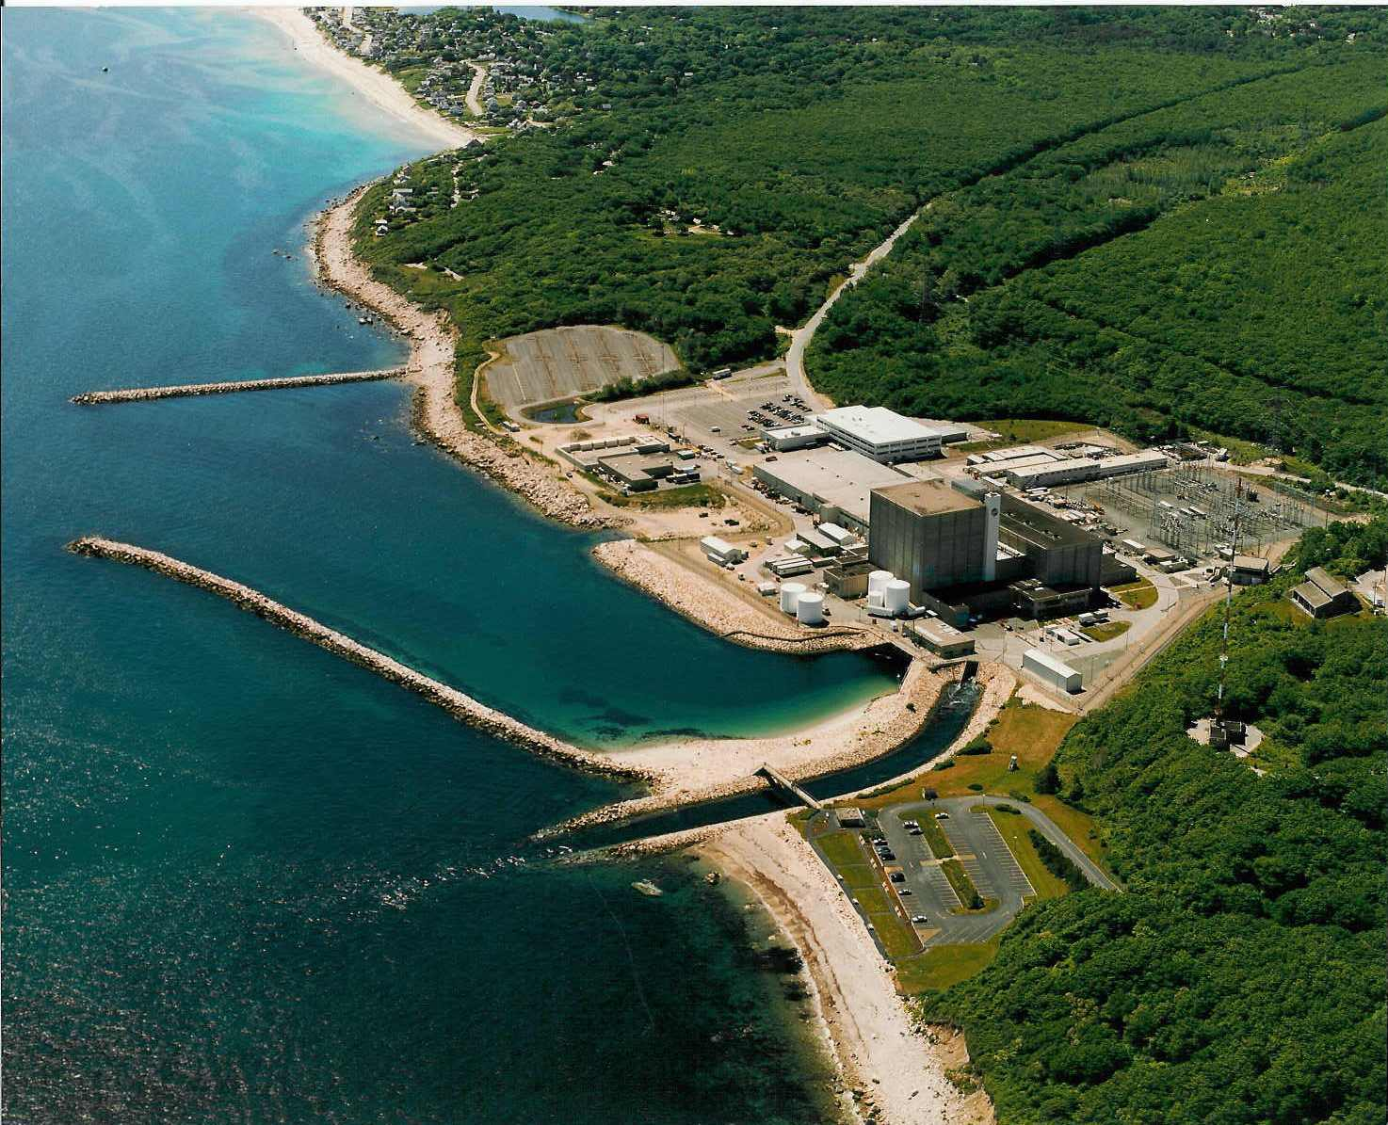
TPL Coverage Definitions
On-Site Bodily Injury
Off-site Bodily Injury
Off-site Property Damage
"Rets-Remp Workshop 2008"
AMERICAN
NUCLEAR
INSURERS

Slide 6
Nuclear Liability Insurance Risk
Recent Global Risk Management Experience – Compliance with Applicable Jurisdictional Regulations does not always offer protection from future liabilities
Nuclear Liability Insurance Risk is Increasing
"Rets-Remp Workshop 2008"
AMERICAN
NUCLEAR
INSURERS

Slide 7
Nuclear Liability Insurance Risk (Effluent Releases)
Increased Public Awareness of NPP Effluent Releases & Perception of Personal Risk
Public does not differentiate between Isotope of Cobalt and Tritium
1 atom Co-60 ~ 1 atom of Tritium (perception)
NPP Releases Cause Harm ! (Perception)
"Rets-Remp Workshop 2008"
AMERICAN
NUCLEAR
INSURERS

Slide 8
ANI Guideline 07-01 - Experience
Fuel Pool Integrity
Sumps
GW Intrusion into Structures
Storage Tanks
Pipe Integrity
"Rets-Remp Workshop 2008”
AMERICAN
NUCLEAR
INSURERS

Slide 9
ANI Guideline 07-01 - Experience
Drinking Water
Storm Drains
Settling Ponds
Sanitary Sewage
On-Site Landfills
Ground Water Monitoring Program
"Rets-Remp Workshop 2008"
AMERICAN
NUCLEAR
INSURERS

Slide 10
Historic Industry Experience
Many sites installed wells to monitor for leaks to groundwater at ANI request.
ANI Recommendations
Underwriting Adjustments
Wells provided indication of piping, pond, tank or SFP integrity breaches
"Rets-Remp Workshop 2008"
AMERICAN
NUCLEAR
INSURERS

Slide 11
More Recent Industry Experience
Site Hydrogeological Characteristics Changed
New Wells Revealing GW Contamination
Pond and Landfill Leaks
Pipe Degradation Resulting in Leaks
Spent Fuel Pool & Transfer Tube Leaks
Sampling Protocols need to Include HTDs
Storm Sewer Integrity
"Rets-Remp Workshop 2008”
AMERICAN
NUCLEAR
INSURERS

Slide 12
Industry Response
ANI Compliments the Industry for the Pro-Active Response & Initiatives Undertaken to Date
Positive Receptiveness of ANI Recommendations and Suggestions
"Rets-Remp Workshop 2008"
AMERICAN
NUCLEAR
INSURERS

Slide 13
ANI Direction
Nuclear Liability Insurance Inspections
Increased Attention in Select Areas
Underwriting Adjustments
"Rets-Remp Workshop 2008”
AMERICAN
NUCLEAR
INSURERS

Slide 14
Closing Remarks
Progress
Still Work to Do
"Rets-Remp Workshop 2008”
AMERICAN
NUCLEAR
INSURERS

