Slide 1

Overview of NRCDose and Dose Assessments Using ICRP-72 Dose Factors
2009 RETS/REMP Workshop
J. Stewart Bland
788 Sonne Drive, Annapolis, MD USA 21401
410-266-9174
www.chesnuc.com

Slide 2
Topics
NRCDose Overview
Comparison of Dosimetry and Pathway Modeling – Reg Guide 1.109 Dose Factors versus ICRP-72
GALE Code (as time permits)

Slide 3
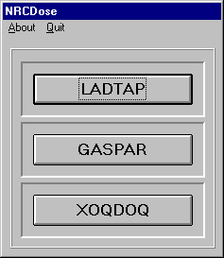
NRCDose

Slide 4
NRCDose
NRCDose is a user‑friendly 16-bit PC-based, software interface for the LADTAP II, GASPAR II, and XOQDOQ programs which operates under all Microsoft WindowsTM platforms.
LADTAP II, GASPAR II, and XOQDOQ are programs developed by NRC for implementing Regulatory Guides 1.109 and 1.111, which were originally created for mainframe computers and written using the FORTRAN programming language.
These dose modeling codes are currently being used for license renewal evaluations. the NRC’s programs industry standards.
While still utilizing the FORTRAN code, NRCDose incorporates a WindowsTM based interface, which allows the user to enter and retrieve data through a series of windows. This graphical interface allows the user to create sets of data that can be named and retrieved at a later date for review or modification.

Slide 5
NRCDose File Structure
There are several different file extensions that should be noted while using NRCDose. Files with the .DAT extension are data files that are used by LADTAP and GASPAR in place of manually entered data. These files will be used when initially testing the two programs. Files with the .LNP, .GNP, and .XNP extension are files saved from within the LADTAP, GASPAR, and XOQDOQ modules, respectively. Refer to the comments on saving files later in the manual.
The current version of NRCDose contains test cases that can be used to verify the functions of each program. After installation, a file folder titled “Test” will appear in the NRCDose directory. Input files created within the individual modules (those with .LNP, .GNP, and .XNP extensions) and created externally (those with .DAT extensions) are available.
For files created externally (those with .DAT extensions), the Variables menu option and Create Input File button will be disabled. It is assumed that the input file contains all necessary information prior to being imported into the program.

Slide 6
NRCDose Installation
Insert the CD into the appropriate disk drive.
“Open” the contents of the CD-ROM by double clicking on the appropriate drive or icon. Double click the Setup.exe icon.
-or-
Choose RUN from the Start Menu. When the Run dialog appears, type: x:\setup.exe (x represents the appropriate drive letter.
You will see the message "Initializing setup." Initialization may take a few moments. The Setup program will then ask you to specify a directory on your hard disk for the " NRCDose " files. You can accept the default directory, C:\NDOSE, or choose another drive and/or directory.
The Setup program automatically creates a program group in Windows and places the NRCDose icon within it.

Slide 7
Starting NRCDose
To start NRCDose, go to the directory where the program was installed and double click the NDOSE.EXE icon. The screen shown will appear. Select the desired program by clicking on the bar with the mouse cursor.

Slide 8
LADTAP

Slide 9
LADTAP
LADTAP II implements the radiological exposure models described in Regulatory Guide 1.109, Rev. 1 for routine releases in liquid effluent.
Calculates the radiation exposure to man from potable water, aquatic foods, shoreline deposits, swimming, boating, and irrigated foods, and also the dose to biota.
Doses are calculated for both the maximum individual and for the population and are summarized for each pathway by age group and organ.
Four different age groups are included in the dose assessments - infant, child, teen, and adult. LADTAP II also calculates doses to certain representative biota other than man in the aquatic environment such as fish, invertebrates, algae, muskrats, raccoons, herons, and ducks using models presented in WASH‑1258.
Reconcentration, if any, of each nuclide is determined from one of the three models (complete mixing, partial mixing or plug-flow) available in the program, or the user may input the reconcentration factor if none of the models available in the program is appropriate.

Slide 10
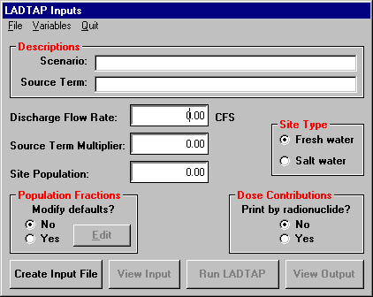
LADTAP Inputs

Slide 11
LADTAP File Structure
Other File menu options include Open LNP, Open DAT, Save, Save as, and Delete.
  Open allows the user to load a previously prepared data input file. Files with the .LNP extension are files that have been saved from within the LADTAP module.
  Files with the .DAT extension were created outside the program.
Selecting Open LNP will display all saved files within the NRCDose directory.
Selecting Open DAT will display only those files with the .DAT extension.
Save allows the user to save currently loaded values to an open data input file. Periodic manual backup of the data input files (those with .LNP extensions) is also recommended. Save will save the file with a .LNP file extension.

Slide 12
LADTAP -- Creating a New Record
To create a new data input file, click on the File menu option. A pop-up menu will appear with the following options: New, Open LNP, Open DAT, Save, Save as, and Delete.
Click on the New option. The controls associated with a new data input file will change to black
The Scenario text box in the Descriptions frame is the input corresponding to Record Type 1 of the LADTAP input record.
The Source Term text box in the Descriptions frame is the input corresponding to Record Type 4.
Enter a description for this entry, and a description for the Source Term.

Slide 13
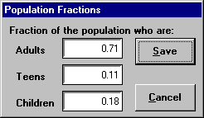
LADTAP – Population Fraction
The Site Population text box is the input corresponding to Record Type 3.
The Population Fractions frame accommodates inputs for optional Record Type 3a. To change the default population fractions, click on the Yes option button in the Population Fractions frame and then click on the enabled Edit button.
Dialog will be presented for input. Change the presented default values as desired and press Save to accept the values or Cancel to ignore any changes, and return to the previous dialog.

Slide 14
LADTAP – Remaining Records
The remaining items are inputs corresponding to Record Type 2.
The only Record Type 2 input not presented here is IFLAG, which relates to block data modification and printing. IFLAG can be modified by accessing Block Data from the Variables drop-down menu (discussed later).
Click on the Variables menu option. This will present the drop-down menu offering "Source Term," "ALARA Analysis," "Fish Usage Locations," "Population Usage," "Irrigation Food Data," "Biota Exposures," "Reconcentration Model," and "Block Data" selections. The following describes data inputs relative to each of the presented menu items:

Slide 15
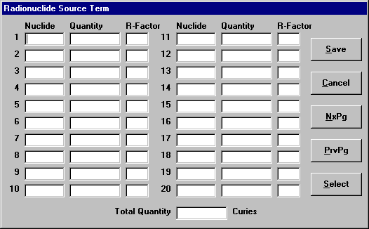
Source Term
Dialog specifying the source term values corresponding to Record Type 5 of the LADTAP input record.
Enter radionuclide values (Ci) by typing the nuclide name in the “Nuclide” field and the quantity (in Ci) under the “Quantity” field.
The nuclide name format should be typed in the format "A#M," where A and M represent letters and # represents numbers. Examples are: "C14," "Ag110m," "zn65," "CO60," etc. No hyphens are allowed.
Quantity values represent curies per year (or time period of interest) entered as real numbers with decimals or in scientific notation.

Slide 16
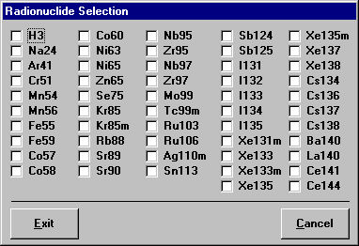
Selecting Radionuclides
There are several validations, which occur when entering radionuclide and quantity information:
  You cannot enter a quantity unless a corresponding radionuclide name has been specified.
  You cannot enter duplicate radionuclides.
  The radionuclide must exist in an internal file, which contains a listing of acceptable radionuclides (nuclides contained in LADTAP.LIB).
When first entering nuclide information for a new release, use Select button to display a dialog listing the most common nuclides expected to be present in releases. Click on the check box for the desired nuclides and then click Done, which will list the selected radionuclides on the previous dialog for entry of their associated release quantity.

Slide 17
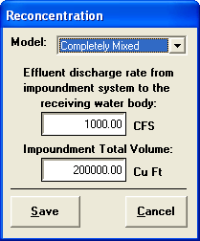
Reconcentration Modeling
The R-Factor on the Source Term input screen may be used for inputting a user-defined reconcentration factor (used when no reconcentration model is selected). The default value is 1.
Three RG 1.113 models (simple) for cooling ponds included:
  Complete Mixed
  Plug-Flow
  Partial Mixed

Slide 18
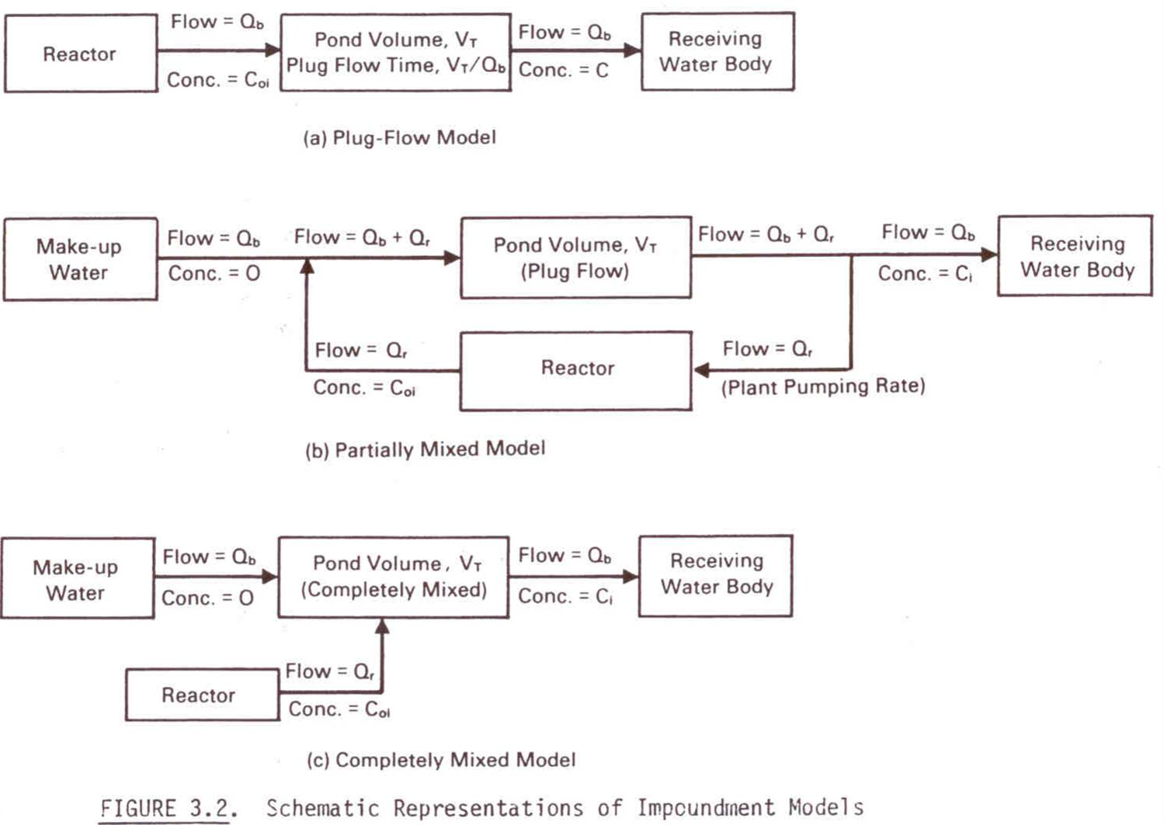
Reconcentration Modeling

Slide 19
Reconcentration Modeling (con’t)
Plug-Flow Model
  uniform, constant flow through pond; negligible evaporation
Partially Mixed Model
  Applicable where blowdown and plant pumping significant
Completely Mixed Model
  Estimates effluent concentration at midpoint of plant life
  Refer to NUREG/CR-4013, Section 3.1.1 for more detail

Slide 20
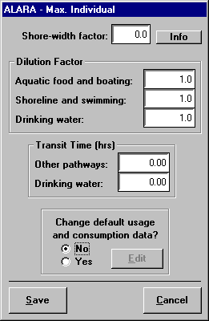
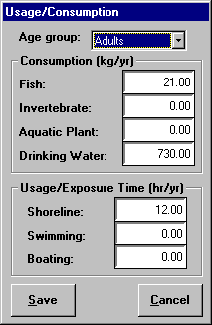
ALARA Dose Analysis
Drop-down menu offering choice of "Max Exposed Individual" and "Additional Usage Locations" data entry dialogs. The following describes data inputs relative to the presented menu items:
  Max Exposed Individual... - presents the dialog for modification of the variables corresponding to Record Type 7 of the LADTAP input record.
  To change the default usage and consumption data, click on the Yes option button in the Population Fractions frame and then click on the enabled Edit button. A dialog will be presented for editing.

Slide 21
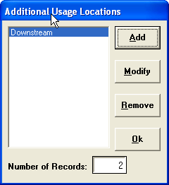
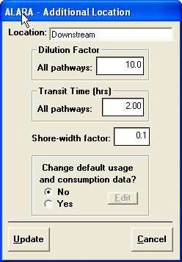
Additional Locations
Locations for additional dose calculations can be added (Record Types 7a-7d).
Add - clicking on this button presents an additional location data entry dialog for entry of the variables corresponding to Record Type 8. A descriptive name for the location can be entered at this time. The bottom frame accommodates inputs for optional Record Types 8a-8d. To change the default usage and consumption data, click on the Yes option button in the Population Fractions frame and then click on the enabled Edit button. A dialog like that shown in Figure 4.7 will be presented for editing.

Slide 22
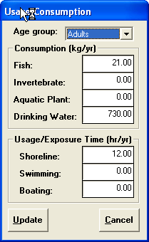
Changing Default Usage and Consumption Data
  The bottom frame accommodates inputs for optional Record Types 8a-8d.
  To change the “default usage and consumption data” click on the Yes option button in the Change Default frame and then click on the enabled Edit button.
  A dialog will be presented for editing. Click the Update button to accept the changes or the Cancel button to ignore any changes and return to the previous dialog.

Slide 23
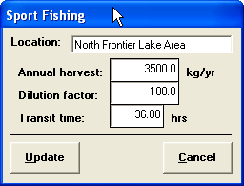
Fishing Usage – Population Doses
Drop-down menu offering choice of "Sport Fishing," "Commercial Fishing," "Sport Invertebrate Harvest," and "Commercial Invertebrate Harvest" data entry dialogs.
  Sport Fishing... - presents the dialog like that shown in Figure 4.8 for selection of the usage/harvest locations to be edited. The functions presented by the command buttons are similar to those described above under ALARA Analysis - Additional Usage Locations. The data entry dialog permits entry and modification of variables, which correspond to the Record Type 9 inputs.
  Commercial Fishing... - same as Sport Fishing above, for Record Type 10 inputs.
  Sport Invertebrate Harvest... - same as Sport Fishing above, for Record Type 11 inputs.
  Commercial Invertebrate Harvest... - same as Sport Fishing above, for Record Type 12 inputs.

Slide 24
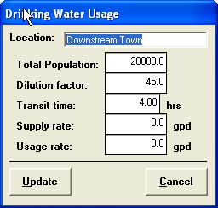
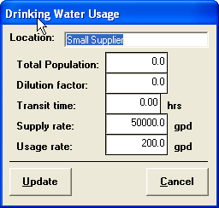
Population Usage – Drinking Water, Shoreline, Swimming, and Boating
Drop-down menu offering choice of "Drinking Water," "Shoreline," "Swimming," and "Boating."
  Drinking Water... selection of the drinking water locations to be edited. Permits entry and modification of variables, which correspond to the Record Type 13 inputs.
  Shoreline... - same as Drinking Water above, for Record Type 14 inputs.
  Swimming... - same as Drinking Water above, for Record Type 15 inputs.
  Boating... - same as Drinking Water above, for Record Type 16 inputs.

Slide 25
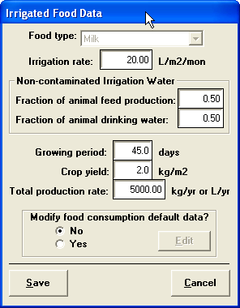
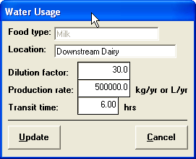
Irrigation Food Data
Drop-down menu offering choice of "Pathway" and "Water Usage Locations" data entry dialogs. These inputs represent Records 17 and 18, which are treated as a data set
  Pathway... selection of the food pathways to be edited. The data entry dialog permits entry modification of variables, which correspond to the Record Type 17 inputs. The bottom frame accommodates inputs for optional Record Types 17a.
  Water Usage Locations... selection of the food pathways to be edited. Drop-down list box for selecting the food type. The data entry dialog presented permits entry modification of variables, which correspond to the Record Type 18 inputs.

Slide 26
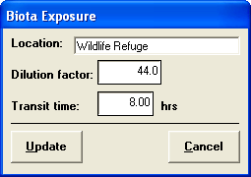
Biota Exposures
Dialog for selection of the biota locations to be edited. Doses calculated using simplistic modeling from BNWL-1754
  Data entry dialog permits entry modification of variables, corresponding to the Record Type 19 inputs.
  Doses to fish, invert., algae, muskrat, raccoon, heron, duck.
  Better modeling available – DOE Guidance, RESRAD Biota.

Slide 27
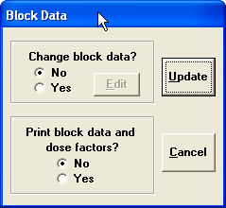
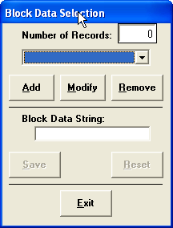
Block Data – Changing Standard Dose Factors and Bioaccumulation Factors
Dialog for modification of the variables corresponding to the IFLAG parameter for Record Type 2.
  To change block data, click on the Yes option button in the upper frame and then click on the enabled Edit button.
  A dialog for selection of the block data strings to be edited will be presented. The data entry dialog permits entry/modification of the block data strings. Refer to LADTAP User’s Manual.

Slide 28
Running LADTAP
Create Input File button will prepare an input record (LAD_INP.DAT) for use by LADTAP
Run LADTAP button will execute LADTAP using this input record.
  Since LAD_INP.DAT is an ASCII text file it can be edited externally using an ASCII text editor. Using the guidance of the LADTAP II technical reference the user can edit the input record manually and still run it under this interface. For that matter an entire input record can be created externally and renamed to LAD_INP.DAT, copied to the NRCDose directory, and executed under this Windows program.
Typically, after entering all of the needed data for the type of output desired or opening a previously prepared file, the user would click on Create Input File to generate the LAD_INP.DAT file. Then click on the Run LADTAP button.
After the data has been processed, a viewer similar to that seen in the View Input window will appear.

Slide 29
LADTAP Output
The output for LADTAP is sent to a file titled LAD_OUT.DAT.
  To view this output externally, open the file with a word processing program
  The output of the data may then be formatted (the output should be formatted in landscape mode rather than portrait) and saved to the user’s specifications.
The edited file should be saved under a new name, since any subsequent entries in LADTAP will replace existing data in the LAD_OUT.DAT file.

Slide 30
GASPAR

Slide 31
GASPAR
GASPAR implements the methodologies of Regulatory Guide 1.109, Rev. 1.
Output from XOQDOQ (discussed later) is used as meteorological data input to GASPAR.
The special locations are used for evaluating maximum-exposed individual doses and standard radial distances and segments are used for population doses.
Seven exposure pathways are included within GASPAR - plume immersion, groundplane exposure, inhalation, vegetation, cows milk, goats milk, and meat.
External exposure doses to the total body and skin are calculated for releases of noble gases using semi-infinite plume dose conversion factors coupled. Iodine and particulate releases are not included in direct exposure dose calculations. Similarly, groundplane, inhalation, and food pathways only consider radioiodine and particulate effluents.
GASPAR is configured, with its input and output data and formats, mainly for performing plant design basis evaluations as needed for nuclear power plant licensing. However, it can be used for evaluating routine effluent releases with the input of source term and, as desired, meteorology specific to the time period of interest.

Slide 32
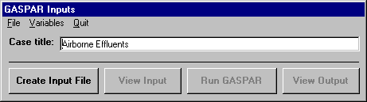
GASPAR
To start the program, click on the GASPAR selection button from the NRCDose main menu. To enter data, you must first create a new data input file, or indicate which existing input file you want to modify. The only available (enabled) dialog options at this time are File and Quit.

Slide 33
GASPAR -- Creating a New Record
To create a new data input file, click on the File menu option. A pop-up menu will appear with the following options: New, Open GNP, Open DAT , Save, Save as, and Delete. Click on the New option.
  The controls associated with a new data input file will change to black (i.e., they will be enabled).
  A default Case Title will be presented in associated text box. This Case Title is the input corresponding to Record Type 1 of the GASPAR input record.
Create Input File command button will use whatever values are currently loaded in the program to prepare an input record (GAS_INP.DAT) for GASPAR.
View Input command button is enabled whenever an input record (GAS_INP.DAT) exists in the program directory. Clicking this button will bring up an ASCII file viewer to view the input file.
Run GASPAR command button will execute the GASPAR program using this input record.

Slide 34
GASPAR Options
Job Control Options
Site Specifics
Population Data
Milk Production Data
Meat Production Data
Vegetable Production Data
Source Terms
Meteorological Data
Special Location Data

Slide 35
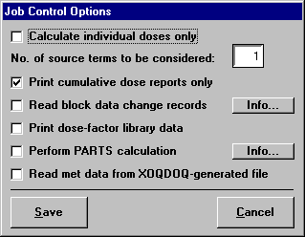
GASPAR – Job Control Options
Dialog for modifying the variables corresponding to Record Type 2 of the GASPAR input record. Change the presented default values as desired and press Update to accept the values
NOTE: If variable JC (7), "Read met data from XOQDOQ-generated file," is checked, a message will appear reminding the user that alternate met data must be prepared prior to completing the GASPAR procedure. This message will appear after the variable has been selected and each subsequent time the Job Controls Option is accessed. Upon clicking "Run GASPAR" from the main program dialog the program will be looking for a file in the same subdirectory, with a name of GAS_XOQ.DAT. This file is the alternate met data created by XOQDOQ for GASPAR.

Slide 36
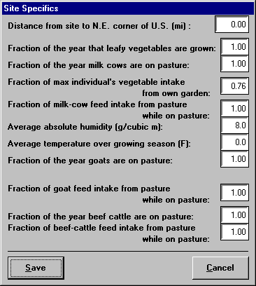
GASPAR - Site Specifics
Dialog for modifying the variables corresponding to Record Type 3 of the GASPAR input record. Change the presented default values as desired and press Update to accept the values.
Average absolute humidity is for the growing season. If blank or zero, default of 8 g/m³ is used. If an average temperature over growing season is input, humidity input should be the relative humidity.

Slide 37
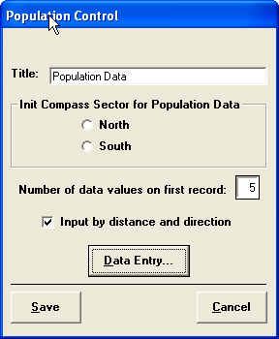
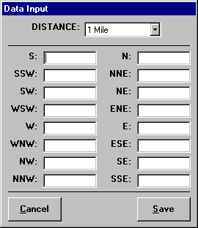
GASPAR - Population Data
Dialog for modifying the variables corresponding to Record Types 4 and 4.1 of the GASPAR input record.
  The "Title" is the only input for Record Type 4.
  Variable IDAT is modified from this program. It is internally defaulted to "0," defining North as the starting compass center.
  Click on the Data Entry... button to display either the dialog for entry of variables corresponding to Record Types 4.1.na and 4.1.nb, or that for entry of variables corresponding to Record Type 4.2.
  Data input values are the number of people in each sector or total 50-mile population.

Slide 38
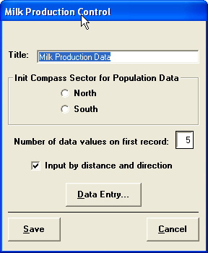
GASPAR - Milk, Meat and Vegetable Production Data
Similar to Population Data above, but relates to Record Types 5, 6 and 7. Refer to the Population Data section for description.
Data input values are in units of L/y (milk) and kg/y (meat and vegetables)

Slide 39
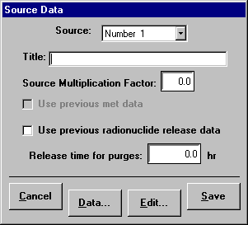
GASPAR - Source Terms
Multiple source terms can be specified for distinguishing between different release points (and different meteorology).
Dialog for selection of the source term to be edited. Click on the desired source term to highlight it for modification of the variables corresponding to Record Types 8 and 8.1 of the GASPAR input record. The "Title" is the only input for Record Type 8.
This dialog permits radionuclide information entry for up to 33 nuclides.

Slide 40
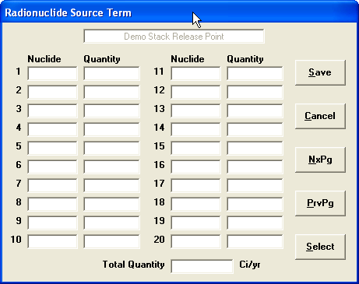
GASPAR - Source Term Input
Enter radionuclide values (Ci) by typing the nuclide name in the field under the "Nuclide" label, then move (or tab) to the adjacent field under the "Quantity" label and enter the corresponding value.
The nuclide name should be typed in the format "A#M," where A and M represent letters and # represents numbers. Examples are: "C14," "Ag110m," "zn65," "CO60," etc.
Note that no hyphens are allowed.
Quantity values may be entered as integers, real numbers with decimals and commas, or in exponential or scientific notation.

Slide 41
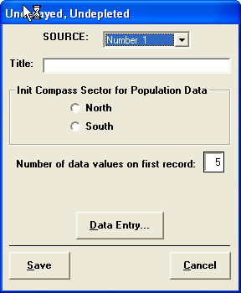
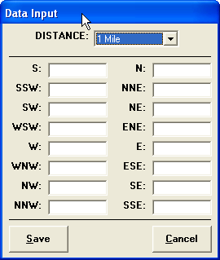
GASPAR - Meteorological Data
Meteorological Data - presents drop-down menu offering choice of "Undecayed, Undepleted," "Decayed, Undepleted," "Decayed, Depleted," or "Ground Deposition" data entry dialogs. Need entry for each Source Term.
  “Undecayed, Undepleted”, “Decayed, undepleted”, and Decayed Depleted”.. - dialog for modifying the variables corresponding to Record Types 9, 10 and 11 GASPAR input record.. Data input units are sec per m³.
  Ground Deposition... - similar to Undecayed, Undepleted above, but relates to Record Type 12. Units are m⁻².

Slide 42
Meteorological Dispersion Parameters – Definitions and Use
  Undecayed, Undepleted: Units are second per m³. No decay during transit; no depletion of plume. This value used for tritium and C-14 calculations.
  Decayed, Undepleted: Units are seconds per m³. Dispersion parameter includes a 2.26 day half-life for decay, which is used to evaluate transport time and a corresponding decay for other noble gases.
  Decayed, Depleted: Units are seconds per m³. Includes an 8 day half-life and plume depletion for inhalation dose calculations for radioiodines and particulates (correcting for decay and depletion).
  Ground Deposition: Units are m⁻². No decay. Used for all nuclides except tritium, C-14, and noble gases for pathways involving ground deposition (e.g., food pathways and groundplane).

Slide 43
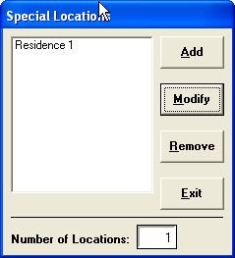
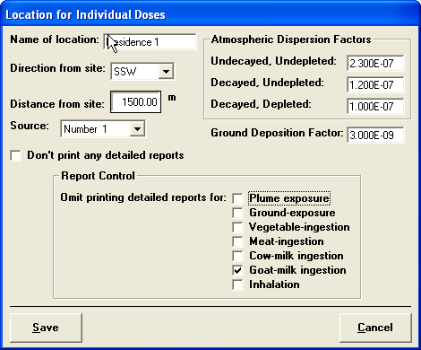
GASPAR – Special Locations
Special Location Data... - presents dialog for selecting special locations for dose calculations.
  Add - clicking on this button presents a special location data entry dialog for entry of the variables corresponding to Record Type 13. A descriptive name for the location can be entered at this time. Only values corresponding to Source Term 1 can be entered at this time.
  Modify – use for modifying the variables Clicking on the Source list box will permit changing and editing of the source terms to be used.

Slide 44
GASPAR File Options and Execution
Open .GNP or .DAT data file
Create Input File button will prepare an input record (GAS_INP.DAT) for use by GASPAR.
Run GASPAR button will execute GASPAR using the input record. Since GAS_INP.DAT is an ASCII text file it can be edited externally using an ASCII text editor. An entire input record can be created externally and renamed to GAS_INP.DAT, copied to the NRCDose directory, and executed.
Run GASPAR button will excute the program. After the data has been processed, a viewer similar to that seen in the View Input window will appear.

Slide 45
GASPAR Output File
The output for GASPAR is sent to a file titled GAS_OUT.DAT. To view this output externally, open the file with a word processing program. The output of the data may then be formatted) and saved to the user’s specifications. The edited file should be saved under a new name, since any subsequent entries in GASPAR will replace existing data in the GAS_OUT.DAT file.

Slide 46
XOQDOQ

Slide 47
XOQDOQ
XOQDOQ designed for evaluating routine releases from nuclear power plants.
Primarily designed to calculate annual average relative effluent concentrations (X/Q values) and annual average relative depositions (D/Q values) at user specified locations (for maximum exposed individual dose assessment) and at various standard radial distances and segments (for population dose assessment).
Evaluation of meteorological dispersion for intermittent releases may also be evaluated. Instead of the annual average, less frequent meteorological condition may be assumed. An interpolation is performed for correlating less frequent meteorological condition to the annual average conditions.

Slide 48
XOQDOQ
The meteorological modeling includes consideration of building wake effect, plume depletion due to dry deposition and radioactive decay.
Up to three separate decay half-lives can be specified
  Regulatory Guide 1.111 recommends the use of a 2.26 day half-life for short-lived noble gases and 8 day half-life for iodines.
Release height and plume rise can be modeled or the plume may be modeled as a ground level release.
XOQDOQ can also utilize a so-called “mixed mode” release, where, under certain meteorological conditions, the release is treated as elevated and, under other conditions, as ground level. The combination of these two conditions produces the annual average conditions.

Slide 49
XOQDOQ
The release may be treated as always elevated, always ground level, or a mixed mode, which is primarily used in the analysis of vent release points at or above the height of adjacent structures.
The effluent plume for elevated releases can undergo plume rise due to momentum and/or buoyancy.
Ground-level releases can be affected by additional dispersion due to nearby building wakes.
Wind speeds measured at one level may be extrapolated to other elevations for release point evaluation.
Plume growth parameters (σy and σz) can be described by Pasquill-Gifford curves or desert curves by Markee.
For elevated releases, topography can be inputted for use in calculation of the effective plume height.
The plume may undergo radioactive decay for varied half-lives.
The plume may be depleted via dry deposition.

Slide 50
XOQDOQ
X/Q and D/Q values may be modified by standard or inputted values to account for local air recirculation or air stagnation.
X/Q and D/Q values can be evaluated for predetermined distance segments and for specified points of interest.
The joint frequency data may be inputted as a percent frequency of occurrence or as a total frequency of occurrence.
The wind direction is broken down into the standard sixteen (16) 22.5º sectors (e.g., N, NNE, NE, ENE, etc.). Up to fourteen (14) separate wind speed classes can be modeled and the atmospheric stability is grouped according to seven (7) categories from extremely unstable (A class) to extremely stable (G class).
The output from XOQDOQ may be modified, which will allow its direct use as an input meteorological data set for the GASPAR code.

Slide 51
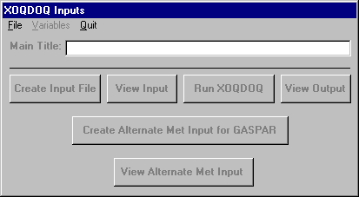
XOQDOQ
To start the program, click on the XOQDOQ selection button from the NRCDose main menu. A dialog will appear. To enter data, you must first create a new data input file, or indicate which existing input file you want to modify.
Creating a New Record:
  To create a new data input file, click on the File menu option. A pop-up menu will appear with the following options: New, Open XNP, Open DAT, Save, Save as, and Delete. Click on the New option.

Slide 52
XOQDOQ - Create Input, and Run
The Create Input File command button will use whatever values are currently loaded in the program to prepare an input record (XOQ_INP.DAT) for XOQDOQ. The View Input command button is enabled whenever an input record (LAD_INP.DAT) exists in the program directory. Clicking this button will bring up an ASCII file viewer to view the input file (similar to Figure 4.3). Use the scroll bars to move around the viewer. To print a copy of the input file, click the Print button.
The Run XOQDOQ command button will execute the FORTRAN-coded XOQDOQ program using this input record.

Slide 53
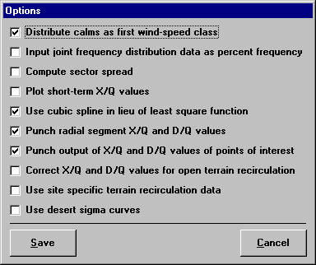
XOQDOQ Variables
Variables menu option presents a drop-down menu offering "Options," "Parameters," and "Wind Data" selections.
Options... - presents the dialog shown for modifying the variables corresponding to Record Type 1 of the XOQDOQ input record. KOPT(11), which calculated using 30º sectors is not changeable from within this program. It is defaulted to "0."
If first option is checked [KOPT(1) = 1], remember to add 1 to NVEL (number of velocity categories), first input in System Parameters dialog box.
Third option [KOPT(3)], option to compute sector spread for comparison to centerline value in purge calculations is not currently operable.

Slide 54
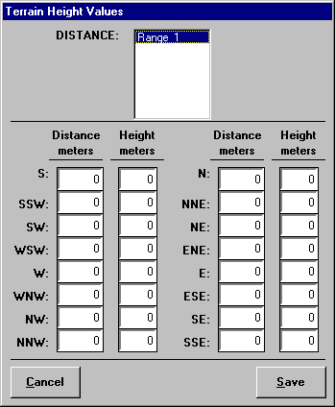
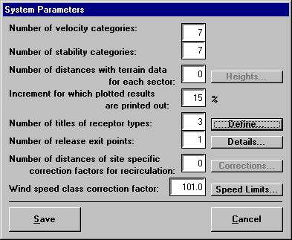
XOQDOQ - Parameters

Slide 55
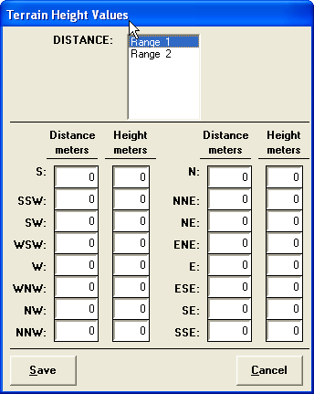
XOQDOQ – Parameters
NDIS variable (number of distances with terrain data for each sector) if greater than "0" enables the associated Heights button.
Clicking on this Heights button displays the dialog for entry/modification of variables corresponding to Record Types 10 and 11.

Slide 56
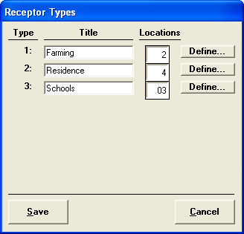
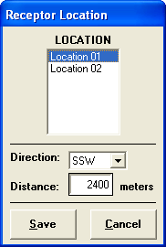
XOQDOQ – Parameters
NPTYPE variable (number of titles of receptor types) if greater than "0" enables the associated Define button.
Filling in a Title enables the adjacent text box for entry of the number of locations (NPOINT), which in turn if greater than "0" enables the associated Define button.
Clicking on this Define button displays the dialog for entering or modifying variables corresponding to Record Type 14.

Slide 57
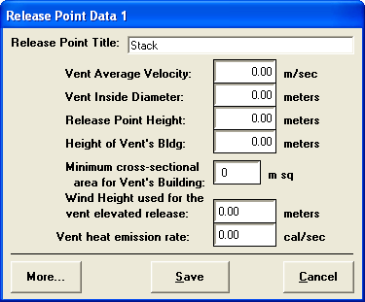
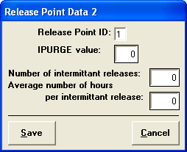
XOQDOQ – Parameters
NEXIT variable (number of release exit points) if greater than "0" enables the associated Define button.
Clicking on this Define button displays dialog for editing release point information.
NCOR variable (number of distances of site specific correction factors for recirculation) if greater than "0" enables the associated Corrections button. Clicking on this Corrections button displays a dialog for entry/modification of variables corresponding to Record Types 8 and 9.

Slide 58
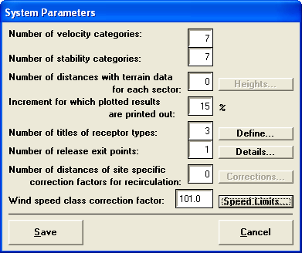
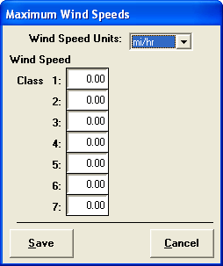
XOQDOQ – Parameters
UCOR (wind speed class correction factor) is part of Record Type 7.
Clicking on the adjacent Speed Limits button displays for entering or modifying the remaining variables corresponding to Record Type 7.
  If KOPT(1) = 1 (option set) , calms are a distinct wind velocity class and appropriate input is required.
  If the wind speed classes are defined in units of miles per hour, the wind speed class correction factor (UCOR) must be a value greater than 100 (use 101) to convert inputs to meters per second.

Slide 59
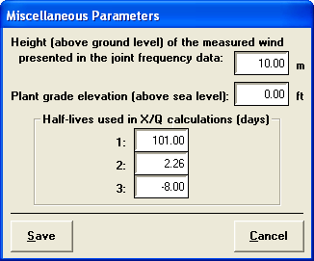
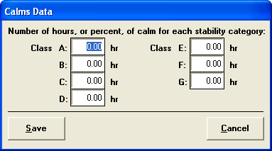
XOQDOQ - Wind Data
Wind Data… presents another drop-down menu offering choice of "Misc Parameters," "Calms Data," and "Joint Freq Data" data entry dialogs.
  Misc Parameters... - presents the dialog for modifying location of the variables corresponding to Record Type 4 of the XOQDOQ input record.
  Calms Data... - presents the dialog for modifying the variables corresponding to Record Type 5 of the XOQDOQ input record.
  Joint Freq Data... - presents the dialog for modifying the variables corresponding to Record Type 6 of the XOQDOQ input record.

Slide 60
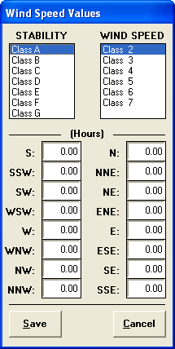
XOQDOQ - Joint Freq Data Input
Joint Freq Data... - presents the dialog for modifying the variables corresponding to Record Type 6 of the XOQDOQ input record.

Slide 61
XOQDOQ File Menu & Structure
File menu options include Open XNP, Open DAT, Save, Save as, and Delete.
Open allows the user to load a previously prepared data input file. These are files with the .XNP extension that have been saved from within the XOQDOQ module.
Files with the .DAT extension were created outside the program.
Open XNP will display all saved files within the NRCDose directory.
Open DAT will display only those files with the .DAT extension.
Save allows the user to save currently loaded values to an open data input file. Periodic manual backup of the data input files (those with XNP extensions) is also recommended.

Slide 62
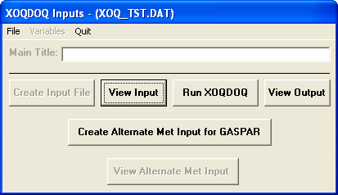
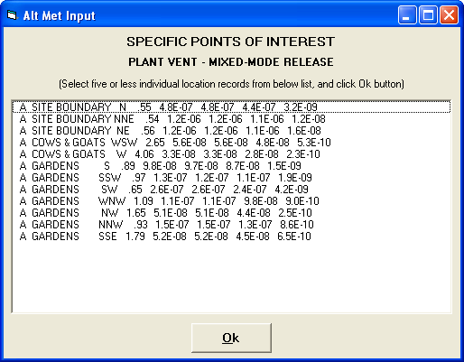
XOQDOQ - Creating Alternate Met Data for GASPAR
XOQDOQ can be used to create alternate met data for GASPAR.
After XOQDOQ has been run, the Create Alternate Met Input for GASPAR command button will become enabled.
Select the desired specific points of interest from the list by clicking the line with the mouse.
When all points have been selected, press the OK button. A similar window will appear for every release exit point established in the XOQDOQ parameters.
The selected data will be saved to a file titled GAS_XOQ.DAT.

Slide 63
Dosimetry and Pathway Modeling

Slide 64
Dose Pathway Modeling
Site-specific hydrology/atmospheric dispersion
Other site-specific ecological factors
  Unique pathways, bioaccumulation
Environmental usage
  Maximum exposed individual
  population dose assessment
Biota doses

Slide 65
Updated Dosimetry and
Pathway Modeling
Dose Modeling
  Probabilistic (90% CL) versus Deterministic
  Update to ICRP 60/72 dosimetry
    Additional age groups
Environmental pathway modeling
  Atmospheric dispersion; aquatic dilution
  Transport and biological accumulation factors
Individual usage factors

Slide 70
Liquid Effluent Source Term Used for Evaluating Doses Based on ICRP-30/72 and RG 1.109 Dose Factors
Nuclide | Typical BWR | Typical PWR
 | (Ci/yr) | (Ci/yr)
³H | 26 | 280
²⁴Na | 1.60E-03 | 1.10E-03
⁵⁴Mn | 1.20E-03 | 3.90E-03
⁵⁵Fe | 2.90E-03 | 7.30E-03
⁵⁹Fe | 6.00E-05 | 2.20E-03
⁵⁸Co | 4.40E-03 | 8.30E-03
⁶⁰Co | 9.90E-03 | 1.40E-02
⁶⁵Zn | 5.40E-04 | 4.00E-05
⁸⁹Sr | 2.00E-04 | 1.00E-04
⁹⁰Sr | 2.00E-05 | 1.00E-05
¹³¹I | 8.10E-02 | 4.60E-02
¹³⁴Cs | 1.30E-02 | 2.20E-02
¹³⁷Cs | 2.40E-02 | 3.00E-02
Based on generic release data from NUREG-0016 for BWR and NUREG-0017 for PWR.

Slide 74
Noble Gases Effluent Source Term
Nuclide | BWR | PWR
 | (Ci/yr) | (Ci/yr)
⁴¹Ar | 38 | -
^{83m}Kr | - | -
^{85m}Kr | 32 | 53
⁸⁵Kr | 240 | 2,000
⁸⁷Kr | 63 | 18
⁸⁸Kr | 95 | 65
⁸⁹Kr | 610 | -
⁹⁰Kr | - | -
^{131m}Xe | 5.1 | 1,600
^{133m}Xe | - | 100
¹³³Xe | 1,800 | 4,800
^{135m}Xe | 990 | 7
¹³⁵Xe | 1,200 | 490
¹³⁷Xe | 1,300 | -
¹³⁸Xe | 1,000 | 6

Slide 82
GALE Code

Slide 83
GALE (Gaseous and Liquid Effluents) Code, Rev. 1
Implements NRC’s radioactive source term development as specified in Regulatory Guide 1.112
Incorporates modeling in ANSI/ANS18.1-1999, “Radioactive Source Term for Normal Operation of Light Water Reactors,” to develop realistic source terms for both the reactor coolant and the secondary coolant
NRC Fortran code, suitable for operation under a PC-based DOS operating system
PWR and BWR versions, each with both a liquid and gaseous version of the program

Slide 84
GALE Code, Rev. 1
PWR and BWR versions of the program are documented in NUREG-0016 (Rev. 1) and NUREG-0017 (Rev. 1), respectively.
The calculations performed with this code are based on:
  Standardized reactor coolant activities recommended by ANS-18.1, Source Term Specification N237, “Radioactive Materials in Principal Fluid Streams of Light-Water-Cooled Nuclear Power Plants,” which ANSI issued in 1976
  The release and transport mechanisms that result in the appearance of radioactive materials in gaseous and liquid waste streams

Slide 85
GALE Code, Rev. 1
The contents of the NUREG documents are as follows:
  The effectiveness of design features employed to reduce the quantities of radioactive materials ultimately released to the environment
  Chapter 1 of the respective NUREG report gives a step-by-step procedure for using the PWR or BWR GALE code along with a description of the parameters which have been built into the code for use with all the respective source term calculations. These parameters, which apply generically to all PWRs or BWRs, have been incorporated into the Code to eliminate the need for their entry in the input files. Other parameters are required to entered in the input file used by the code. Explantions of the data required, along with acceptable means for calculating such data, are given for each required input line.

Slide 86
GALE Code, Rev. 1
  (Contents continued)
  Chapter 2 of each NUREG report provides descriptions of the principal parameters used in the source term calculations and explanations of the bases for each parameter. The parameters have been derived from operating plant experience where data were available. Where operating data were inconclusive or not available, information was drawn from laboratory and field tests and from engineering judgment.

Slide 87
GALE Code, Rev. 1
  (Contents continued)
  Chapter 3 of each NUREG report contains sample input data together with an explanation of the input to orient the user in making the required entries. Also included is a listing of the input data for a sample problem, a discussion of the nuclear data library used, and a FORTRAN listing of the respective program.
  Chapter 4 of each NUREG report lists the information needed to generate source terms for the respective plant design. This information constitutes the basic data required in calculating the releases of radioactive material in liquid and gaseous effluents.

Slide 88
GALE Code, Rev. 1
Generic parameters which apply to all PWR reactors include the following:
  Plant capacity factor = 0.80 (292 effective full power days per year
  Noble gas releases from the containment building are based on a leakage rate of 3%/day of primary coolant noble gas inventory. Releases from the auxiliary building are based on 160 lb/day primary coolant leakage. Releases from the turbine building are based on 1700 lb/hr steam leakage.
  H-3 releases based on 0.4 Ci/yr per MWt
  Ar-41 release via the containment vent is 34 Ci/yr.

Slide 89
GALE Code, Rev. 1
  (PWR parameters continued)
  C-14 release is 7.3 Ci/yr, of which the releases from the containment, auxiliary building and waste gas system are 1.6, 4.5 and 1.2 Ci/yr, respectively.
  Releases of radioactive material in liquid waste from the Turbine Building Floor Drain System is 7200 gal/day at main steam activity.
  Secondary coolant concentrations based on a primary-to-secondary leak of 75 lb/day.

Slide 90
GALE Code, Rev. 1
  (PWR parameters continued)
  Two containment purges per year plus a continous purge specified by the applicant in his containment design.
  Two primary system volumes degassed per year for cold shutdowns plus volumes degassed due to continuous stripping.
  Steam generator partition coefficient for once-through SG for iodines and nonvolatiles is 1.0. For a recirculation U-tube SG the partition factor is 0.01 for iodine and 0.005 for nonvolatiles.

Slide 91
GALE Code, Rev. 1
  (PWR parameters continued)
  Normalized release rate of radioiodine from the main condenser air ejector prior to treatment is 1.7x10³ Ci/yr/µCi/g. To obtain actual iodine release in Ci/yr multiply normalized release by the secondary coolant concentration in µCi/yr and by the iodine partition coefficient (Table 2-6).
  Decontamination factors for condensate demineralizers (deep bed and powdex) are considered to be 2 for Cs and Rb, and 10 for anions and other nuclides.

Slide 92
GALE Code, Rev. 1
  (PWR parameters continued)
  Flow rates and concentration of radioactive materials routed to the liquid radwaste system from the regeneration of the condensate demineralizers are based on:
    Liquid radioactivity flow to the demineralizer is based on the radioactivity of the main steam and the fraction of radioactivity which does not bypass the condensate demineralizers if there is pumped forward flow. The steam generator blowdown radioactivity is added to the condensate radioactivity if the blowdown is processed through the condensate demineralizer.

Slide 93
GALE Code, Rev. 1
  (PWR parameters continued)
    All radioactivity removed from the condensate by the demineralizers are removed from the demineralizer resins during chemical regeneration, and adjusted for radionuclide decay during operation of the demineralizers.
  Decontamination factors for primary coolant purification system mixed bed demineralizers are considered to be 2 for Cs and Rb, 100 for anions and 50 for other nuclides. For cation beds the DF is considered to be 10 for Cs and Rb, 1 for anions and 10 for other nuclides.

Slide 94
GALE Code, Rev. 1
  (PWR parameters continued)
  Calculated source term is increased by 0.16 Ci/yr per reactor using the same isotopic distribution as for the calculated source term to account for anticipated operational occurrences such as operator errors resulting in unplanned releases.

Slide 95
GALE Code, Rev. 1
Generic parameters which apply to all BWR reactors include the following:
  Plant capacity factor = 0.80 (292 effective full power days per year
  H-3 releases based on 0.03 Ci/yr per MWt, half via the liquid pathway and half via the gaseous pathway. Of that released in gaseous effluents, half is released via turbine building ventilation system and the remainder via the containment ventilation system.
  Radioiodine input rate to Main Condenser Offgas System of 6 Ci/yr per reactor downstream of main condenser air ejectors
  Main Condenser Vacuum Pump releases for Xe-133 of 1300 Ci/yr, and for Xe-135 of 500 Ci/yr.

Slide 96
GALE Code, Rev. 1
(BWR parameters continued)
  Radioiodine releases are assumed as a function of operating modes and building release points.
  Ar-41 release from purging of venting of the drywell is 15 Ci/yr.
  Charcoal delay system holdup times for Xe and Kr computed as a function of plant power level, dynamic adsorption coefficient and mass of charcoal. Iodine releases from system considered negligible due to large quantities of charcoal used.

Slide 97
GALE Code, Rev. 1
(BWR parameters continued)
  Decontamination factors for condensate demineralizers (deep bed and powdex) are considered to be 2 for Cs and Rb, and 10 for anions and other nuclides.
  Calculated source term is increased by 0.1 Ci/yr per reactor using the same isotopic distribution as for the calculated source term to account for anticipated operational occurrences such as operator errors resulting in unplanned releases.

Slide 98
GALE Code, Rev. 1
(BWR parameters continued)
  Flow rates and concentration of radioactive materials routed to the liquid radwaste system from the regeneration of the condensate demineralizers are based on:
    Liquid radioactivity flow to the demineralizer is based on the radioactivity of the main steam and the fraction of radioactivity which does not bypass the condensate demineralizers in the pumped forward flow.
    All radioactivity removed from the condensate by the demineralizers are removed from the demineralizer resins during regeneration, and adjusted for radionuclide decay during operation of the demineralizers.

Slide 99
GALE Code Operation on PC
To run the GALE program:
  Open a DOS command window: from the Start Menu select Run, enter “CMD” and click OK
  Move to GALE86 application directory: from the command prompt type “cd \” and press Enter - then type “cd \gale86” and press Enter
  Move to either GALE-PWR or GALE-BWR subdirectory: From the command prompt type “cd \gale-pwr” or “cd \gale-bwr”
  Prepare an input file (*.INP) using a text editor like NotePad and the guidance in the respective NUREG document, say “pwrtest.INP.” An input template file can be used as a starting point.

Slide 100
GALE Code Operation on PC-based DOS Platform (cont.)
  Run the respective batch (*.BAT) file from the command prompt: (typically)
    C:\GALE86\GALE-PWR> runliq pwrtest (Note that file extensions (BAT, INP) are not used)
    Acknowledge deletion message
    Output file would be named “pwrtest.LIQ” or “pwrtest.GAS” for GAS (rungas.bat) run

Slide 101
Questions?

